Slide 1
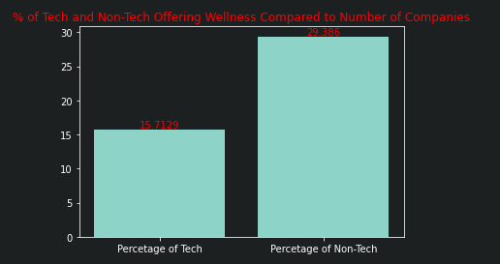
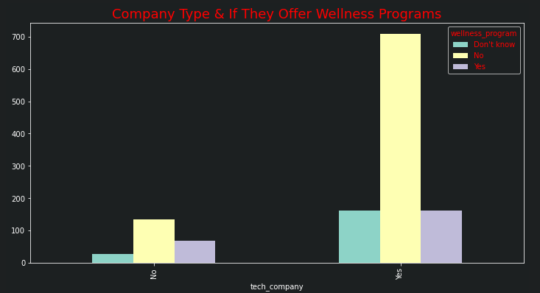
Rizwan Q: is there is a link between tech companies and non-tech companies that offer wellness programs
The Survey Data which was analysed provided the following conclusions:
Tech companies offered wellness programs more than non-tech companies.
Only 15.7 % of Tech Companies offered wellness programs
However 29.4 % of Non-Tech offered wellness programs
Although tech companies do offer more wellness programs, however, the data represents non-tech companies offer more wellness programs overall compared to the volume of companies.

Slide 2
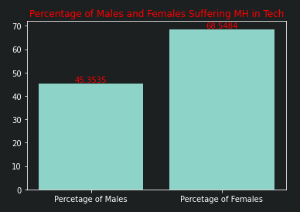
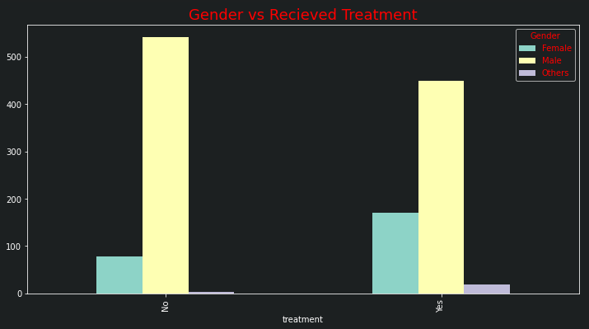
Rizwan H: Women are more likely to suffer from mental health within the tech industry.
The Survey Data which was analysed provided the following conclusions:
Gender vs Treatment demonstrated the number of males who received treatment almost tripled in comparison to females
However when compared to the number of female and male employees in the tech industry the percentage plot demonstrates;
Overall 68.5% of Females in the Tech industry suffer from Mental Health whereas only 45.35% of men do.

